Slide 1
AI in Pavements:
Revolution or Risk?
Jhony Habbouche, Ph.D., P.E.
Western US Regional Engineer
(AZ, CA, HI, NV, OR, and WA)
2025 Nevada Transportation Conference
Wednesday May 14, 2025, Reno, Nevada, USA

Slide 2
Outline
The Many Faces of AI
What Does AI Mean to Us?
AI in Our Daily Life
AI in Civil Engineering
AI in Pavement Engineering
Case Study from Virginia DOT
Revolution or Risk?

Slide 3
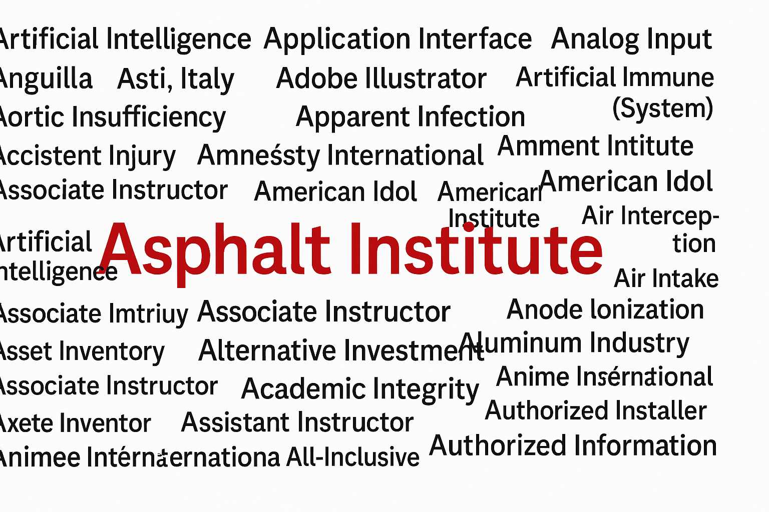
The Many Faces of “AI”
Notes:
Technology & Computing; Geography & Country Codes; Medical & Health; Organizations & Institutions; Aviation & Transportation; Business & Finance; Education & Academia; Engineering & Science; Games & Pop Culture; Miscellaneous

Slide 4






Asphalt Institute - Areas of Strategic Focus
Asphalt Promotion
Health, Safety, and Environ-mental Oversight
Technical Leadership
Educational Expertise
Member Connectivity
AI Headquarters
Lexington, Kentucky
Notes:
The Asphalt Institute is the international trade association of petroleum asphalt producers, manufacturers, and affiliated businesses.
Founded in 1919, the Institute’s members represent 90% of the liquid asphalt produced in North America and an increasing percentage in international markets.
Vision: ensure asphalt is recognized as the construction material of choice.
Mission: promotes the safe use, benefits and quality performance of petroleum asphalts in a unified voice for our membership.
Member Connectivity - A catalyst for member engagement through meetings, programs, and communications
Asphalt Promotion - National, regional, and local marketing efforts to increase the use of asphalt
Health, Safety, and Environmental Oversight - Leveraged sweat-equity and strategic partnerships to achieve solutions to longer-range challenges
Technical Leadership - Professional engineering, research and testing that shapes specifications, standards, and public policy
Educational Expertise - Training and publication of the latest advancements in asphalt technology

Slide 5
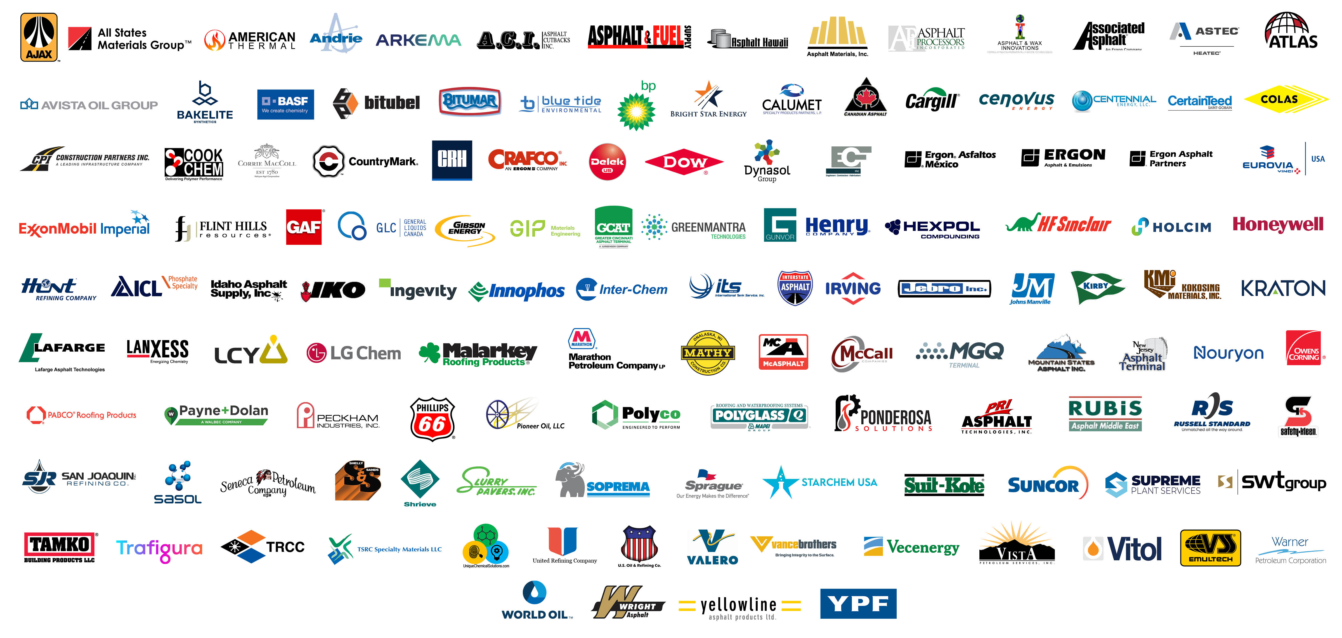
2025 AI Members … Priceless Support

Slide 6
Asphalt Supply-Chain
Notes:
We are the epicenter of the supply-chain.
It describes various associations and agencies representing also individual members and companies
We have out counterpart in Europe represented by Eurobitume
Upstream: asphalt binder obtained from crude oil extraction and refineries; associations representing oil and gas industry: American petroleum institute and American fuel and petroleum manufacturers
Immediate downstream: would be hot mix asphalt producers and contractors represented by NAPA
Asphalt shingle manufacturers represented by ARMA but we also have pavement preservation folks which include emulsion manufacturers which do the preservation activities under PPRA and different in-place recycling activities represented by ARRA.
The final downstream which will be federal, state, local public agencies.

Slide 7





AI - Social Media Connections
Instagram
@AsphaltInstitute
LinkedIn
@asphalt-institute
Facebook
@AsphaltInstitute
𝕏
Twitter
@Asphalt_Inst
Youtube.com/user/AsphaltInstitute

Slide 8
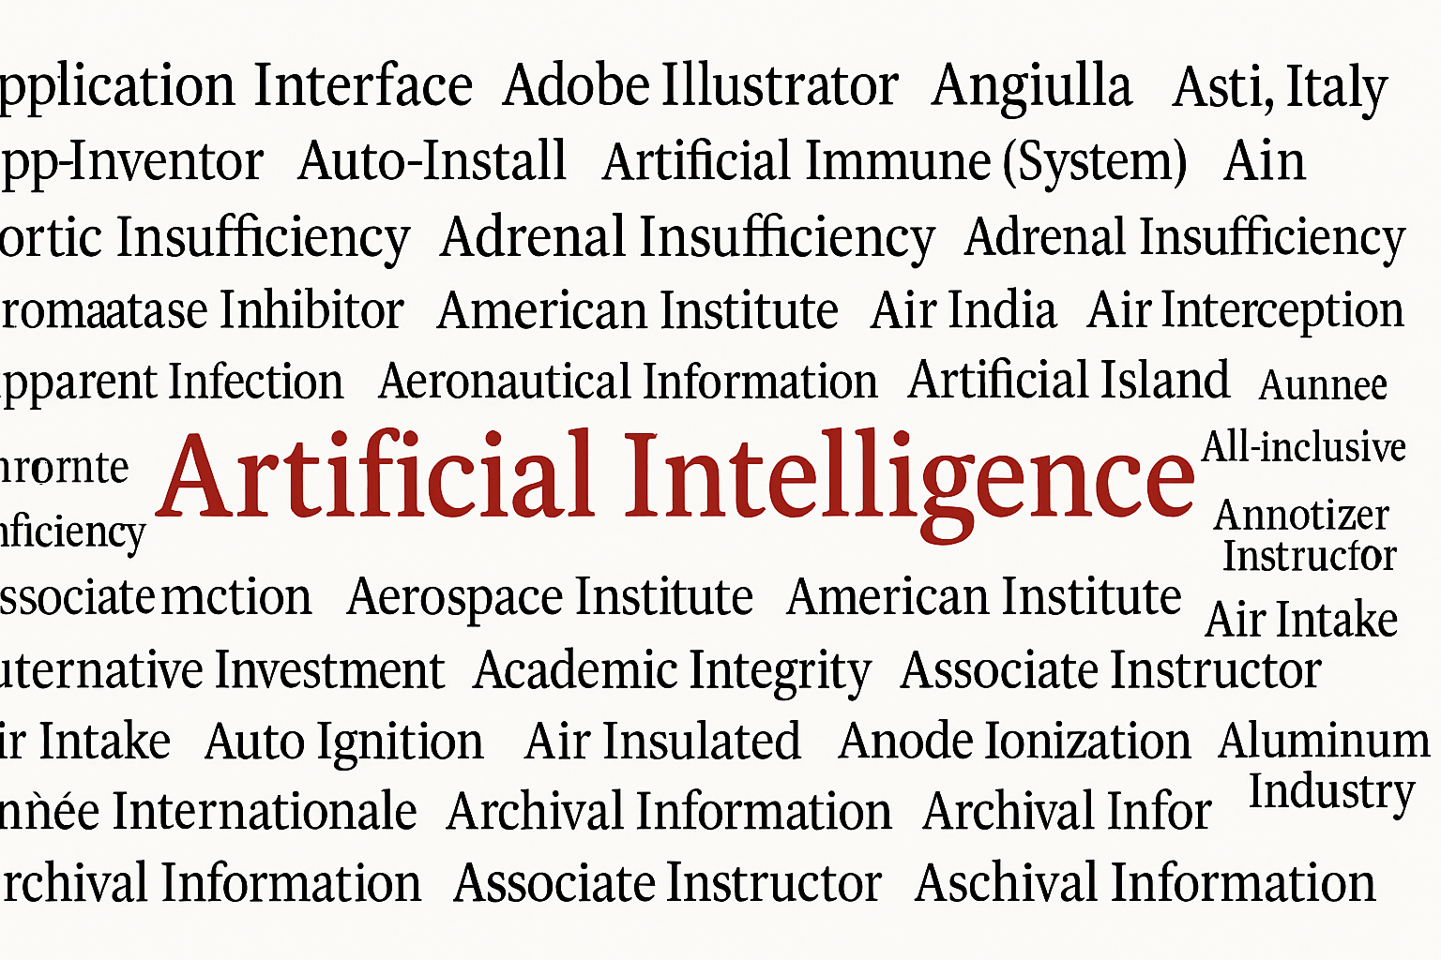
What Does “AI” Mean To Us?

Slide 9

AI Trivia: Question 1
What is currently the most widely used AI tool in the world?
Notes:
As of May 2025, the most widely used AI tool globally is ChatGPT by OpenAI. It boasts over 200 million users and continues to lead the AI landscape in terms of adoption and engagement.
ChatGPT's dominance is evident in web traffic metrics as well. It receives approximately 4.7 billion monthly site visits, significantly surpassing other AI platforms.
The latest iteration, GPT-4o, enhances ChatGPT's capabilities by integrating text, image, and audio processing, offering a more interactive and multimodal user experience.

Slide 10
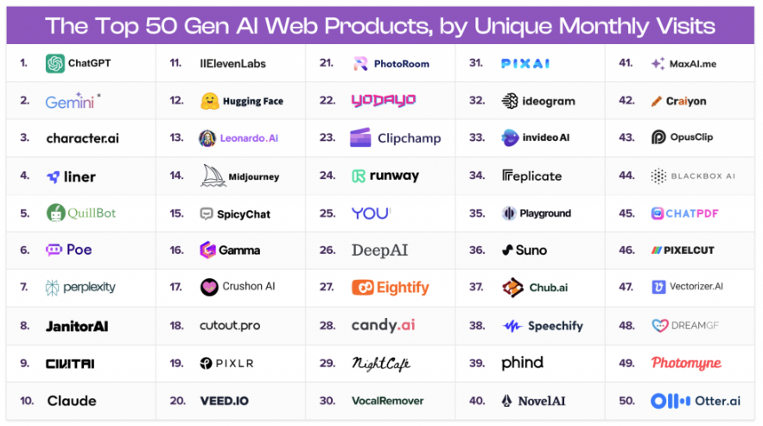
Top 50 Gen AI Web Products
Notes:
While ChatGPT remains at the forefront, other AI tools like Claude by Anthropic and Gemini by Google are gaining traction, offering unique features and expanding the AI ecosystem.

Slide 11
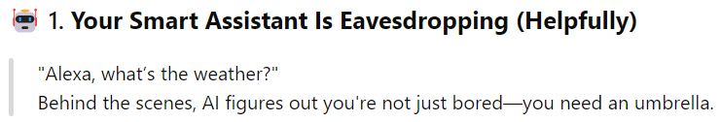


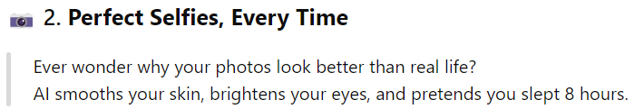



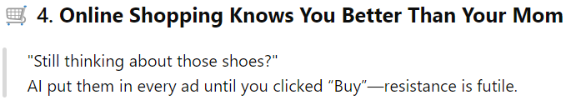
AI in Our Daily Life …

Slide 12

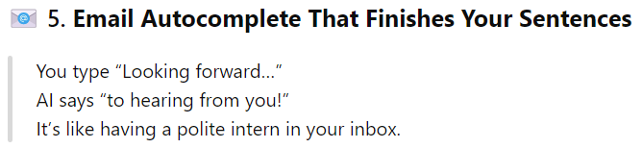


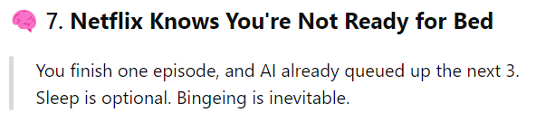

… AI in Our Daily Life
Notes:
📧 Email and Productivity
Examples: Gmail, Outlook.
Use: Spam filters, smart replies, calendar scheduling.
🧠 Health and Wellness
Examples: Fitbit, Apple Health, MyFitnessPal.
Use: Activity tracking, heart rate monitoring, AI-powered diagnostics in healthcare.
💬 Chatbots and Customer Service
Examples: Websites, airlines, banks.
Use: Answer FAQs, guide users, book appointments — often without you realizing it’s AI.

Slide 13

AI in Civil Engineering … The Why
Increasing complexity of infrastructure systems
Need for data-driven decision making
Enhance safety, efficiency, and sustainability
Real-time insights from large datasets

Slide 14

AI in Construction Management
Project Scheduling and Risk Prediction
Autonomous Equipment
Safety Monitoring
Material Tracking and Logistics
AI forecasts delays and cost overruns by analyzing historical data.
Drones, robots, and self-driving machinery operates on job sites with AI guidance.
AI processes site camera footage to detect unsafe behaviors or missing PPE in real time.
AI tracks material inventory and delivery, minimizing waste and downtime.

Slide 15


AI in Structural Engineering
Structural Health Monitoring (SHM)
Failure Prediction
Design Optimization
AI interprets sensor data to detect damage or stress in bridges and buildings.
AI models help predict structural failures by analyzing stress/strain data.
AI-assisted tools to improve design efficiency, reduce material use, and meet performance goals.
1
2
3
Notes:
Therefore, Structural Health Monitoring (SHM) is essential for governments, engineers, and infrastructure asset owners to apply if they want civil infrastructure to continue functioning properly. Remotely monitoring infrastructure with SHM systems provides the following benefits:
Extends the life span of infrastructure
Minimizes maintenance costs
Decreases inspection time
Reduces safety risks for staff
Increases accuracy and reliability
adapt to climate change

Slide 16

Role of AI in Transportation Engineering
Smart Traffic Management
Real-time optimization of traffic signals & intersections; adaptive signal control based on vehicle flow; re-routing strategies.
Air Traffic and Aviation Systems
Flight path optimization to reduce delays and fuel use; maintenance for aircraft systems; decision support ion air traffic control
2
3
4
5
6
1
Autonomous and Connected Vehicles
Self-driving car navigation and decision-making algorithms; V2V & V2I communication; AI in drones & delivery systems
Logistics and Freight Movement
Dynamic route planning & load optimization; supply chain monitoring; warehouse automation & delivery robotics
Safety and Surveillance Systems
Detecting unsafe driving and traffic violations; incident detection & emergency response management; monitoring at airports, tunnels, and railway stations
Public Transit Optimization
AI models for route planning & schedule optimization; real-time passenger demand prediction; fleet management for buses, trains …

Slide 17




AI Trivia: Question 2
Which City became one of the first to implement an AI-based predictive model for traffic accidents?
Los Angelos
B. Singapore
C. Oslo
D. London
Notes:
Singapore uses AI to predict and prevent crashes by analyzing traffic flow and historical data.
Singapore has been at the forefront of integrating Artificial Intelligence (AI) into its transportation systems to enhance traffic management and safety. Beginning as early as 2006, the Land Transport Authority (LTA) collaborated with IBM to pilot a traffic estimation and prediction tool. This system utilized historical traffic data and real-time feeds to predict congestion levels up to an hour in advance, achieving prediction accuracies above 85%, and nearing 90% during peak hours Wikipedia.
Further advancements were made under Singapore's Smart Mobility 2030 plan, which aimed to manage the increasing travel demand without expanding road infrastructure. Between 2017 and 2022, daily travel demand surged from 9 million to 16 million journeys, with projections reaching 20 million by 2030. AI-driven traffic management systems implemented during this period led to a 20% reduction in peak-hour delays and a 15% improvement in average speeds during rush hours Medium.
In addition to traffic flow optimization, Singapore has explored AI applications in public transportation safety. A notable initiative involved a trial with SMRT, one of Singapore's major public transport operators, where AI was used to predict the likelihood of bus drivers being involved in accidents. By analyzing road performance data and driver behavior, the system aimed to identify at-risk drivers and provide them with targeted training before any incidents occurred .GovInsider
These initiatives highlight Singapore's commitment to leveraging AI for proactive traffic management and accident prevention, setting a benchmark for smart city transportation systems worldwide.

Slide 18


AI Trivia: Question 3
Which Science Fiction idea is actually becoming reality? Thanks to AI in Transportation
Self-Driving Cars
Notes:
Once a sci-fi dream, now in real-world testing and limited use!

Slide 19
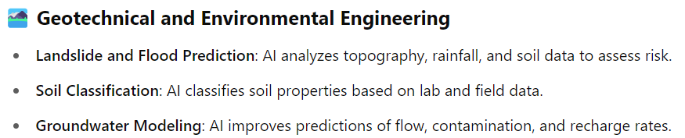
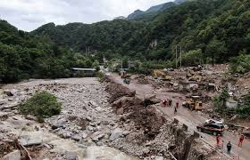
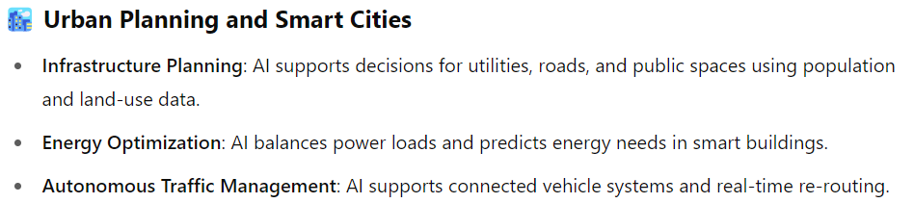
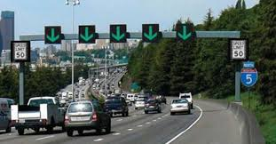
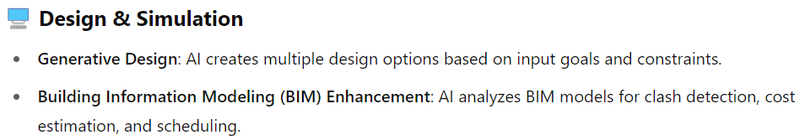

AI in Other Civil Engineering Domains …

Slide 20
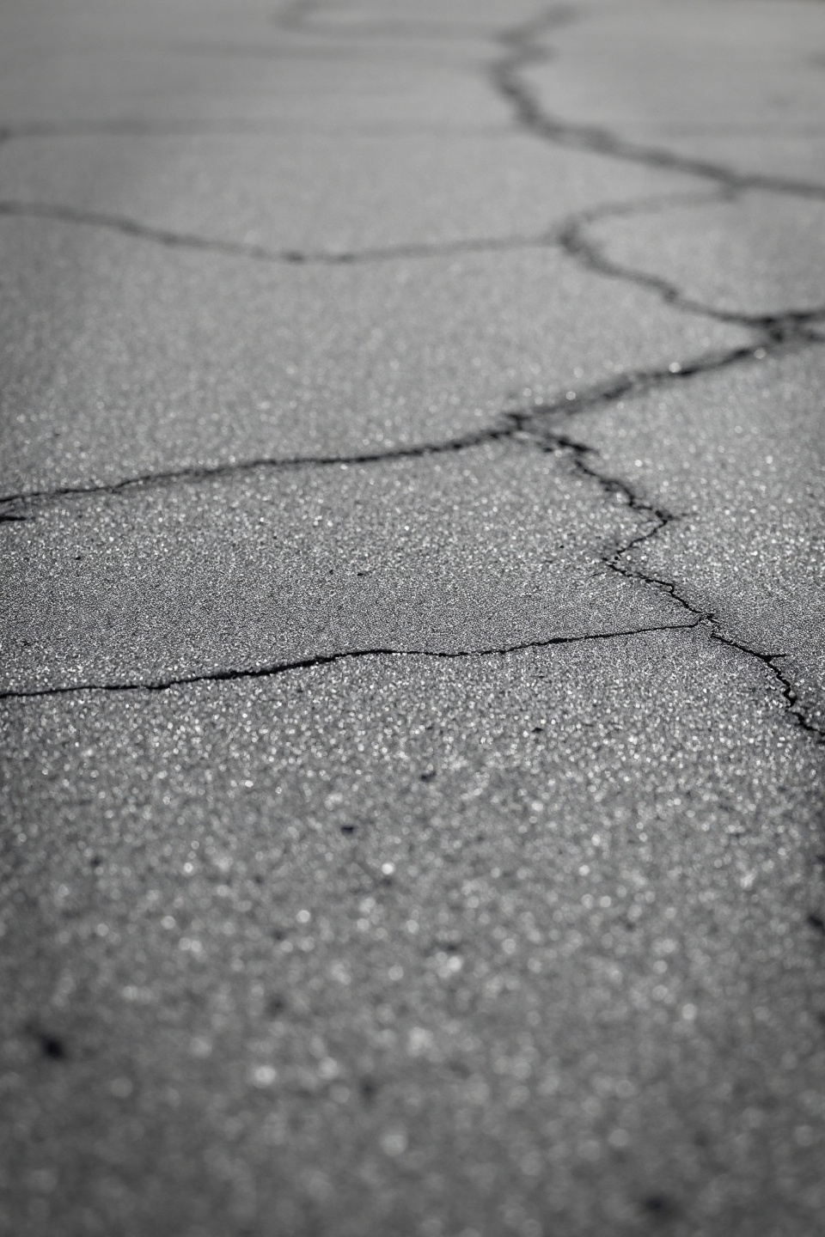
AI in Pavement Engineering …
Pavement Performance Prediction
  Machine learning models to forecast rutting, cracking, IRI, and overall performance.
  Long-term performance models using traffic, climate, and material behavior data.
Distress Detection and Optimization
  Computer vision systems to automatically detect and classify surface distresses (Cracks, potholes, raveling).
  Drone- or vehicle-mounted image / video analysis with real-time diagnostics.
Material Design and Optimization

Slide 21
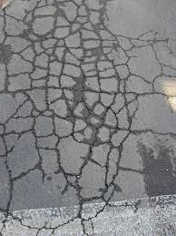
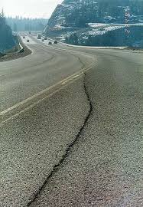
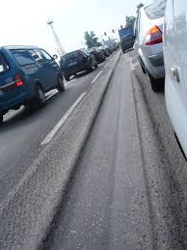
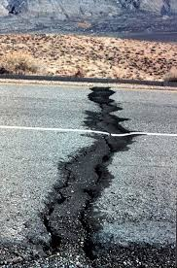
AI Trivia: Question 4 – Guess the Distress
Alligator Cracking (Fatigue Cracking)
Longitudinal Cracking
Rutting
Thermal Transverse Cracking

Slide 22

… AI in Pavement Engineering
Pavement Management Systems (PMS)
Construction Quality Control and Monitoring
Ai-driven decision support tools to prioritize rehabilitation strategies & maintenance scheduling; optimize LCCA.
Intelligent compaction systems; automated detection of construction anomalies using sensors and AI algorithms.
Recycling and Sustainability Analysis
Structural Health Monitoring
Embedded sensors to monitor in-situ pavement conditions; real-time alerts through anomaly detection algorithms.
Modeling of environmental impacts using big data and AI for greener pavements.

Slide 23
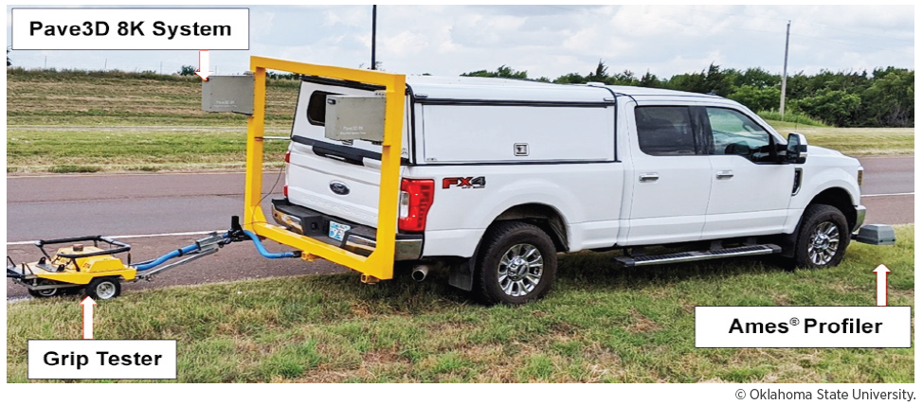
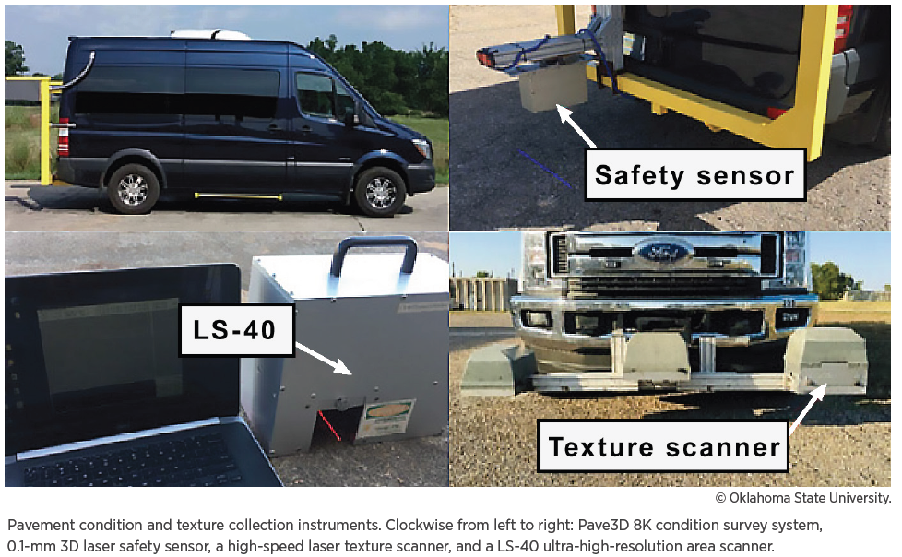

AI To evaluate Pavement Condition & Safety

Slide 24
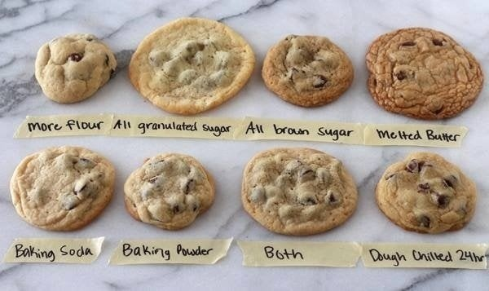
Are All Chocolate Chip Cookies The Same?
I think everyone understands that if you use different ingredients in cookies, they will turn out differently.
What other things might influence how your cookies look and taste?
quality of ingredients
getting the ingredient proportions correct
undercooking / overcooking
experience of the chef
home made vs. store bought
How can we ensure our cookies will be delicious? FOLLOW THE RECIPE

Slide 25
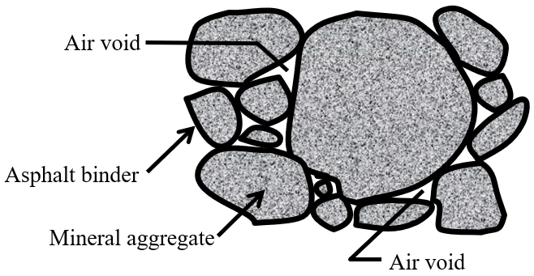
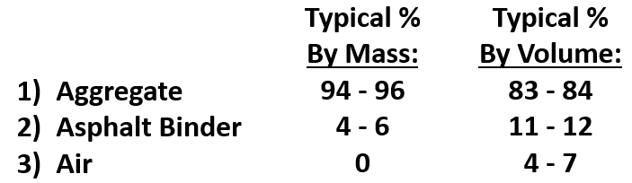
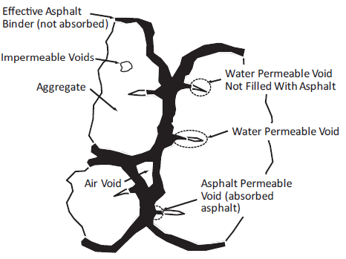
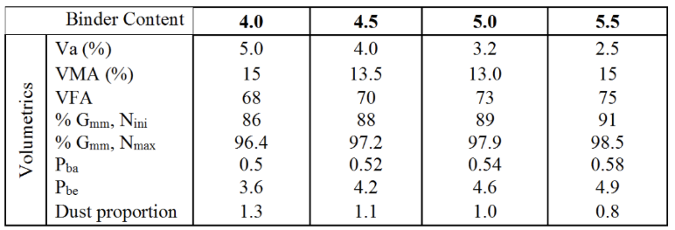
Asphalt Mixtures 101

Slide 26
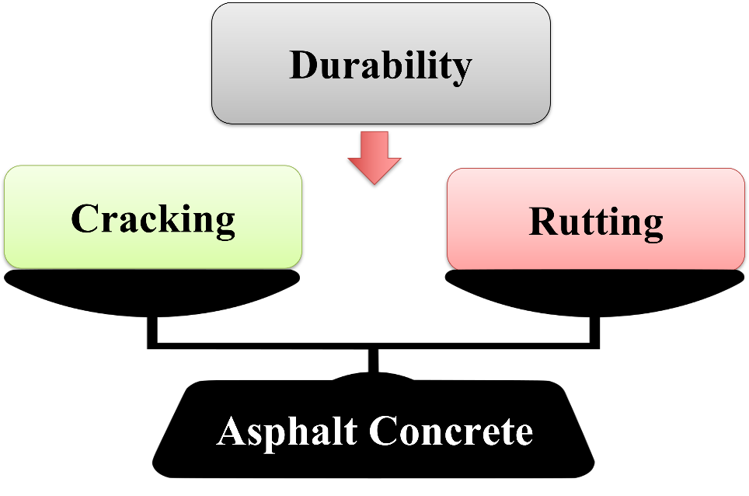
Balanced Mix Design (BMD)
Limitation of Volumetric Design:
                No direct indication of performance
                Cannot capture the impact of different components on current asphalt concrete: RAP, special additives, recycling agents, modifiers…
                Requires assumptions for calculating volumetric parameters in mixtures with recycled materials
BMD is defined as:
  “Asphalt mix design using performance tests on appropriately conditioned specimens that address multiple modes of distress taking into consideration, mix aging, traffic, climate, and location within the pavement structure” (AASHTO PP 105-20)
Why BMD?
  To improve performance to achieve longer lasting pavement
BMD is defined as:
  “Asphalt mix design using performance tests on appropriately conditioned specimens that address multiple modes of distress taking into consideration, mix aging, traffic, climate, and location within the pavement structure” (AASHTO PP 105-20)

Slide 27

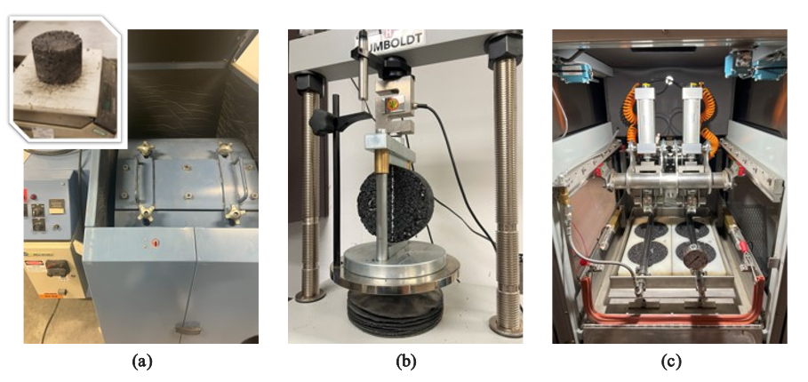
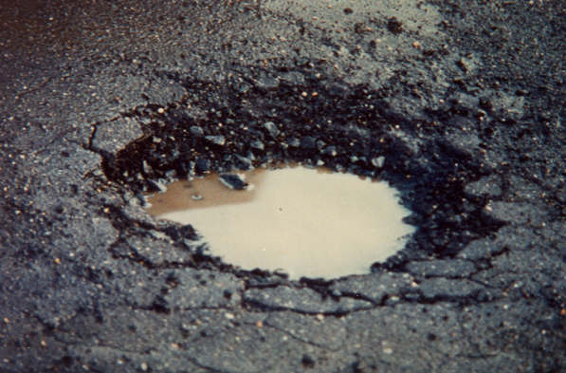
VDOT BMD Specification
Cracking
Indirect Tensile (IDT) Test (ASTM D8225)
CT index ≥ 70
(for design and reheats)
CT index ≥ 95
(for non-reheats)
Rutting
Asphalt Pavement Analyzer (APA) Rut Test (AASHTO T 340)
RD ≤ 8.0 mm
Indirect Tensile at High Temperature Test (VTM 145)
St ≥ 133 kPa (Dry)
St ≥ 100 kPa (Wet)
Durability
Cantabro Mass Loss Test (AASHTO TP 108)
CML ≤ 7.5 %
Moisture Damage
Tensile Strength Ratio Test
(AASHTO T 283)
TSR ≥ 80 %
Notes:
Briefly describe VDOT’s BMD spec

Slide 28
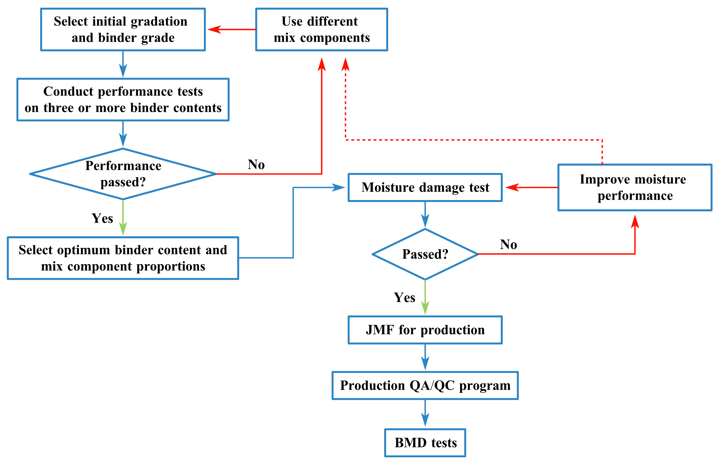
Challenges in BMD
♦ Design Process: Validated through a series of laboratory performance tests, with potential challenges and risks of redesigning.
♦ Production Variability: Difficulty in identifying key factors due to the complex interactions between constituent material properties.
Notes:
Machine learning is a branch of artificial intelligence (AI) that gives computers the ability to learn from data and make decisions or predictions without being explicitly programmed for every specific task.
In Simple Terms:
It’s like teaching a computer by example — instead of giving it strict rules, you feed it data and let it figure out patterns and relationships on its own.

Slide 29
Evaluated Mixtures – Volumetrics / Design
Mixture ID | Mixture I 30_C | Mixture II 30_O | Mixture III 45_HR | Mixture IV 45_HR_RA | Mixture V 45_HR_L | Mixture VI 60_HR_L_RA
Description | Non-BMD | BMD | BMD HRAP | BMD HRAP | BMD HRAP | BMD HRAP
Composition
RAP Content, % | 30 | 30 | 45 | 45 | 45 | 60
Asphalt Binder | PG 64S-22 | PG 64S-22 | PG 64S-22 | PG 64S-22 | PG 58-28 | PG 58-28
Additives | WMA | WMA | WMA | WMA + RA | WMA | WMA + RA
Property
N_{design}, gyrations | 50 | 50 | 50 | 50 | 50 | 50
NMAS, mm | 9.5 | 9.5 | 9.5 | 9.5 | 9.5 | 9.5
Asphalt Content, % | 5.6 | 6.0 | 6.8 | 6.2 | 6.0 | 6.0
Rice SG (G_{mm}) | 2.531 | 2.517 | 2.497 | 2.519 | 2.521 | 2.538
VTM, % | 4.0 | 2.1 | 5.2 | 2.7 | 4.2 | 1.5
VMA, % | 16.8 | 15.9 | 20.2 | 16.9 | 17.9 | 15.3
VFA, % | 76.2 | 87.0 | 74.3 | 84.0 | 76.6 | 90.0
FA Ratio | 1.0 | 1.1 | 1.2 | 1.2 | 1.3 | 1.5
Mixture Bulk SG (G_{mb}) | 2.429 | 2.465 | 2.367 | 2.452 | 2.415 | 2.500
Performance Properties at Optimum Asphalt Binder Content
Cantabro Mass Loss, % | 2.9 | 3.2 | 4.1 | 2.8 | 2.7 | 4.0
APA Rut Depth at 64°C, mm | 5.4 | 4.2 | 5.6 | 7.2 | 4.9 | 3.7
CT index at 25°C | 58 | 112 | 299 | 96 | 141 | 128
Notes:
Developed ML models, including LR, RF, XGB, and SVR, to predict BMD performance indices based on mixture properties collected during both the design and production at a project level:
Identified the key factors in the BMD production.
Proposed integrating ML into the BMD to optimize its performance and effectiveness during the design phase.
Machine learning is a branch of artificial intelligence (AI) that gives computers the ability to learn from data and make decisions or predictions without being explicitly programmed for every specific task.
In Simple Terms:
It’s like teaching a computer by example — instead of giving it strict rules, you feed it data and let it figure out patterns and relationships on its own.

Slide 30
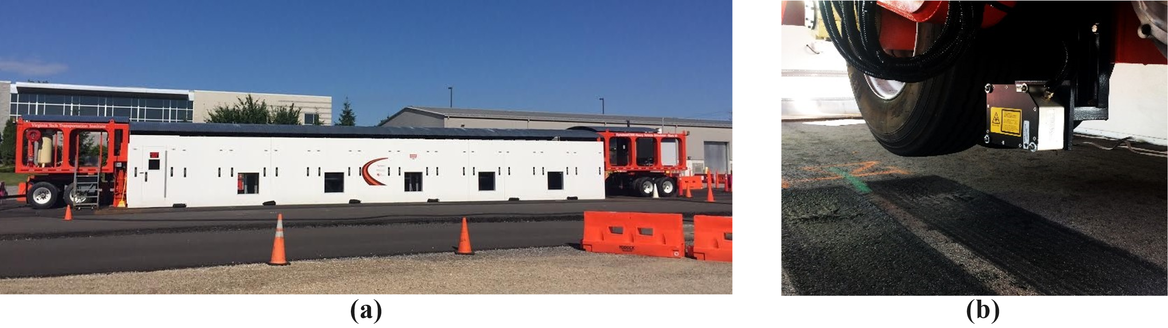
APT Experimental Program
Virginia APT Facility
Laser Profile Mounted on the Carriage
Pavement Structure
Site Layout
Notes:
Six APT lanes were constructed with one mixture placed in each lane. Each lane was 300 ft long and 10 ft wide. Within each lane, five test cells (labeled A through E) were established. Test cells A, C, and E were specifically designated as the test cells for comprehensive data collection. Test cells B and D served as backup test cells to address unforeseen issues or unexpected damage during the experiment. Each test cell was 24 ft long, and the five test cells were positioned in the center 200 ft of each lane. Space between each test cell provided room for the HVS support structure. Figure 1 provides a visual representation of the site layout for APT.
The pavement structure was consistent across all six constructed lanes. Each lane was built with a research mixture consisting of two 1.5-inch lifts, with a total thickness of 3 inches. Each research mixture was placed on top of a 12-inch VDOT 21B base layer, followed by an additional 26-inch layer of VDOT 21B as a subgrade layer.
The central component of the APT experiment was the Dynatest HVS Mark VI shown in Figure 2a. This system featured an environmental chamber designed to maintain a consistent temperature at the loaded area. The HVS automatically regulates the surface temperature to ensure continual maintenance of the desired temperature at a depth of 2 inches from the surface. A dual tire carriage was mounted inside the environmental chamber. Loading was applied using a dual tire assembly with 11.00R22.5 tires inflated to a pressure of 105 pounds per square inch. The system allowed for the completion of approximately 12,000 unidirectional passes or 24,000 bidirectional passes within a 24-hour period. The total load for the dual tire carriage ranged from approximately 9,000 to 15,000 pound-force (lbf).
A laser profiler installed on the HVS carriage, shown in Figure 2b, scanned the pavement surface to quantify the rut depth present at the surface.

Slide 31
Experiment Workflow

Slide 32
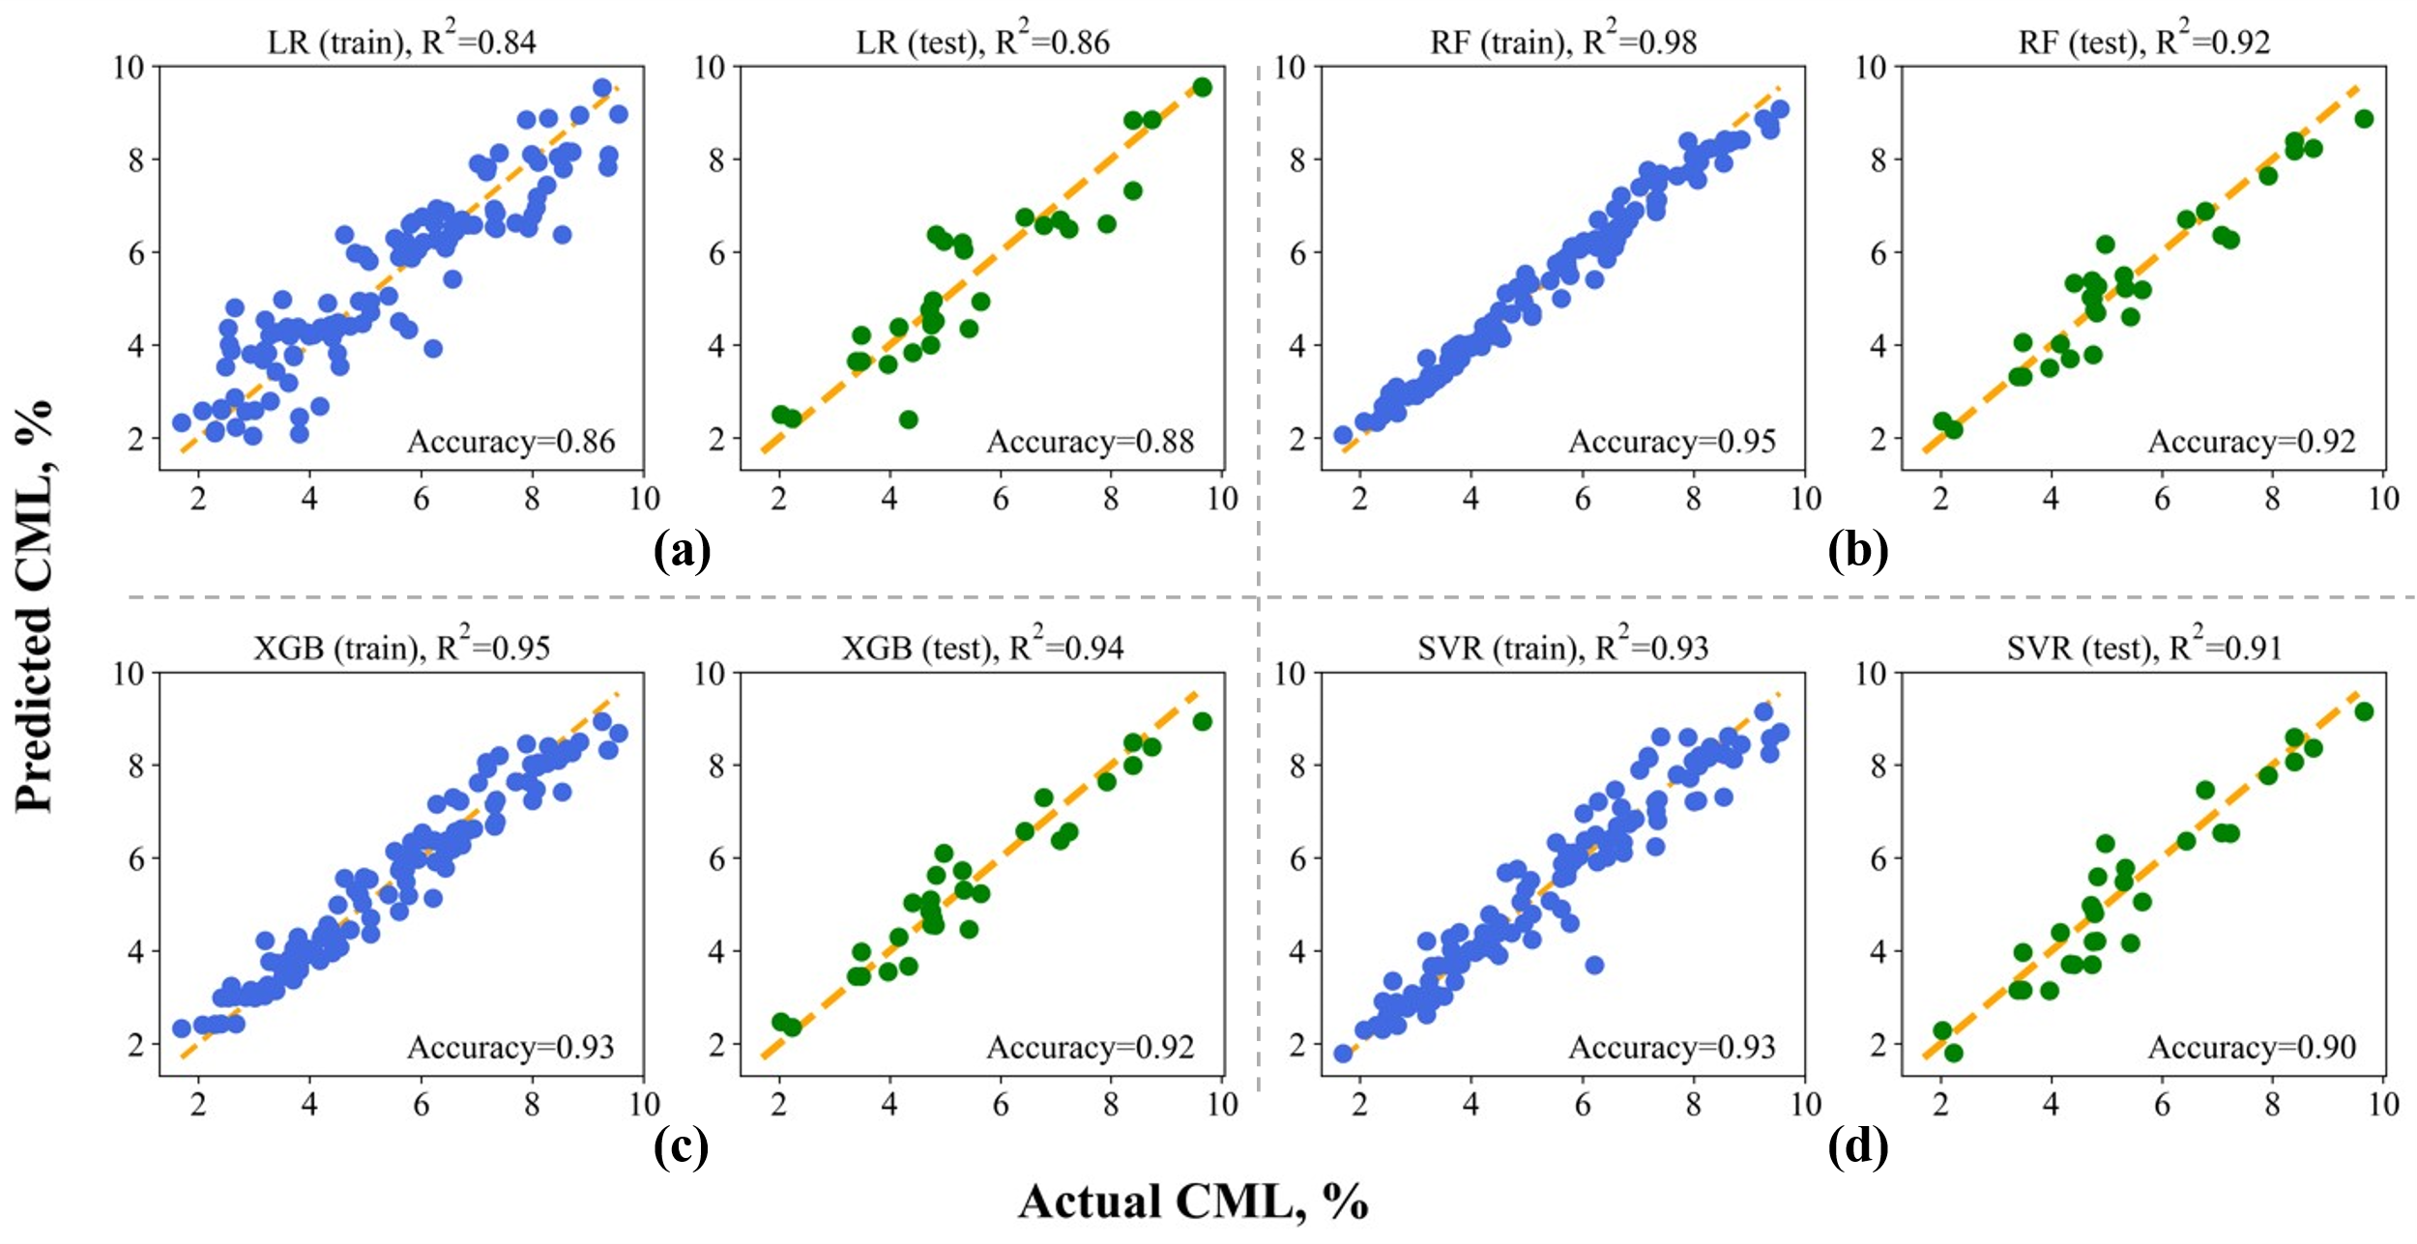
Cantabro Mass Loss (CML) Prediction

Slide 33
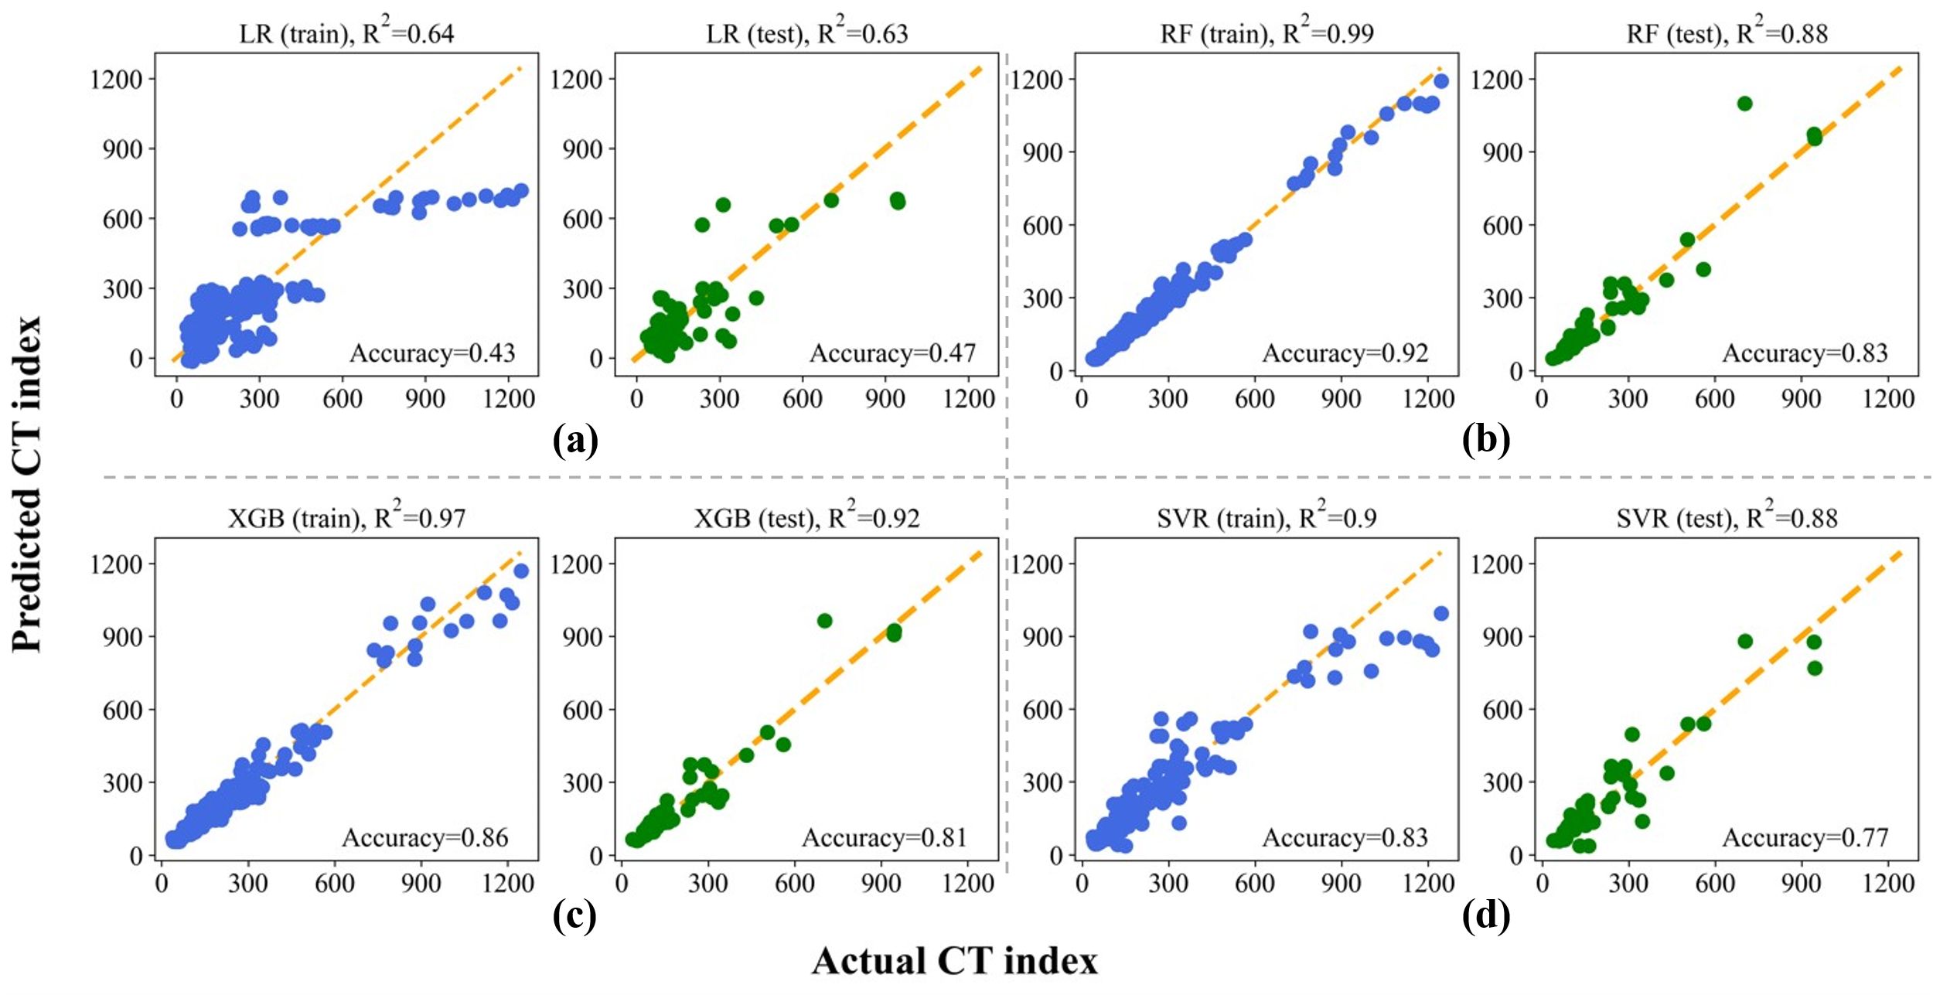
Cracking Tolerance (CT) Index Prediction

Slide 34
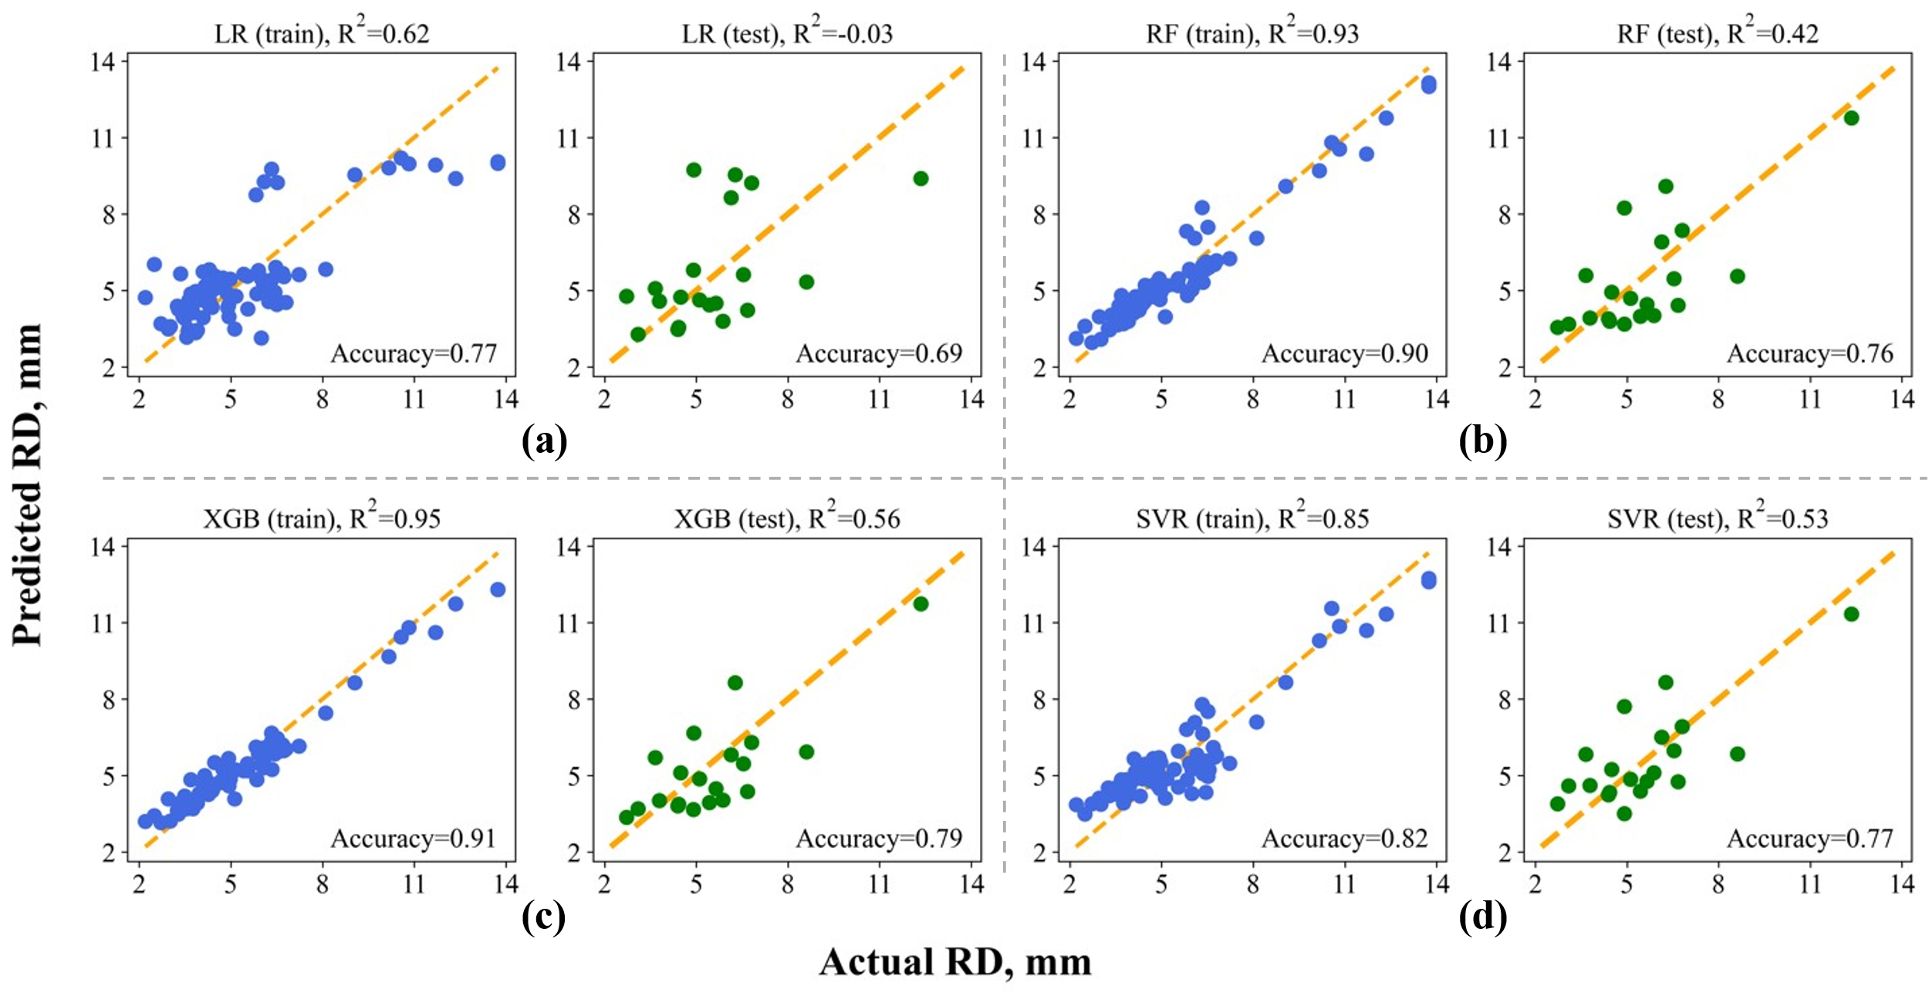
APA Rut Depth (RD) Prediction

Slide 35
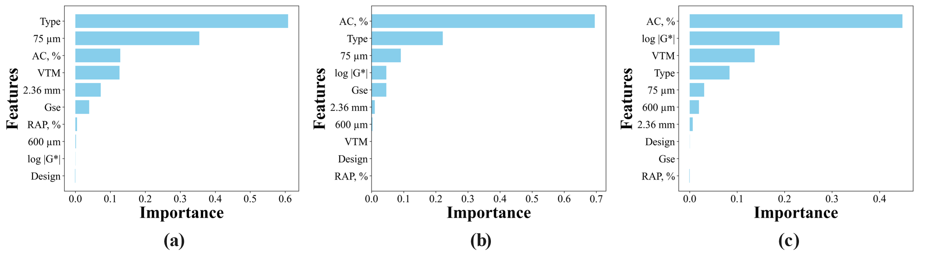
Feature Importance
Permutation Importance Method
Figure. Feature importance from the permutation importance method for: (a) CML from XGB, (b) IDT-CT index from RF, and (c) APA RD from RF model.

Slide 36
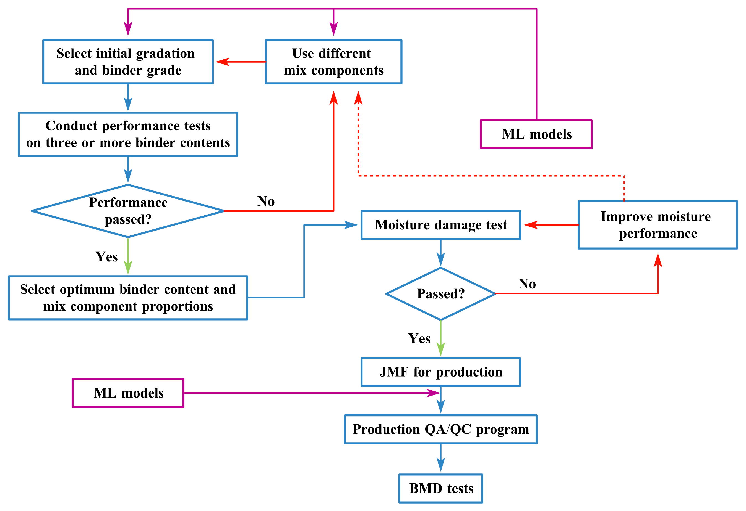

Integrating AI / ML in BMD
Machine Learning–Based Prediction and Optimization of Balanced Mixture Design Performance Indices
Notes:
The idea of this paper was demonstrated in this plot. If we incorporate ML models in the BMD framework, we maybe able to optimize the current BMD during both design and production.

Slide 37
AI in Pavements – Revolution?
Real-Time Pavement Condition Monitoring
Predictive Maintenance Instead of Reactive Repairs
Smarter Asphalt Mix Design
Construction Quality Control Automation
Enhanced Use of Recycled Materials
Life-Cycle and Environmental Impact Modelling
Digital Twins for Pavements
Notes:
here are several powerful and forward-looking ideas on how Artificial Intelligence (AI) could revolutionize pavement engineering:
🔍 1. Real-Time Pavement Condition Monitoring
AI + sensors + drones to continuously assess pavement surface and subsurface conditions.
Early detection of cracks, rutting, and moisture damage with automated alerts.
Eliminates the need for manual, time-consuming visual inspections.
🛠️ 2. Predictive Maintenance Instead of Reactive Repairs
Machine learning models can forecast when and where pavement will fail.
Enables data-driven maintenance scheduling, extending service life and reducing costs.
Supports proactive budgeting and prioritization in pavement management systems (PMS).
🧪 3. Smarter Asphalt Mix Design
AI models optimize mix components (binder, RAP, aggregate) for performance and sustainability.
Faster iteration than traditional trial-and-error lab methods.
AI can learn from historical mix performance to improve new designs.
🎯 4. Construction Quality Control Automation
Intelligent compaction systems adjust roller passes in real-time for optimal density.
Cameras and sensors on pavers detect segregation, temperature issues, and laydown defects.
AI ensures consistent quality with less human error.
♻️ 5. Enhanced Use of Recycled Materials
AI predicts the impact of different RAP/RAS combinations on performance.
Evaluates how rejuvenators interact with aged binders.
Supports more sustainable pavement design without sacrificing durability.
🌍 6. Life-Cycle and Environmental Impact Modeling
AI simulates full pavement life-cycle scenarios (construction to rehabilitation).
Helps minimize carbon footprint, energy use, and cost over time.
Supports climate-resilient infrastructure decisions.
🧠 7. Digital Twins for Pavements
AI powers real-time virtual models of pavement sections linked to sensor data.
Engineers can test “what-if” scenarios before applying changes in the real world.

Slide 38
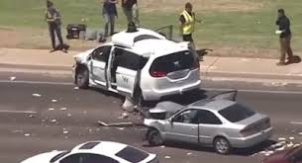
AI in Pavements – Risk?
Data Quality and Bias
Over-Reliance on the Algorithm
Lack of Transparency (Black Box Problem)
Skill Gap and Resistance to Adoption
Cybersecurity and Data Privacy
High Implementation Costs
Notes:
hile AI offers many opportunities, it also brings potential risks and challenges in pavement engineering that are important to consider. Here are a few:
⚠️ 1. Data Quality and Bias
AI models are only as good as the data they’re trained on. Poor-quality, incomplete, or biased pavement performance data can lead to inaccurate predictions.
Example: A model trained on dry-climate roads may perform poorly in snowy or coastal regions.
🧠 2. Over-Reliance on the Algorithm
Engineers might place too much trust in AI outputs without questioning or validating them.
Risk: Decisions could be made based on black-box results that don’t reflect site-specific conditions.
🔍 3. Lack of Transparency (Black Box Problem)
Many AI models, especially deep learning ones, don’t easily explain how they reach conclusions.
In pavement design or QA/QC, this lack of transparency could raise concerns in legal, safety, or auditing contexts.
🔧 4. Skill Gap and Resistance to Adoption
Pavement engineers may lack the training to properly interpret or use AI tools.
Without proper integration, AI may be misapplied or ignored, leading to missed opportunities or flawed outcomes.
🔐 5. Cybersecurity and Data Privacy
As more pavement monitoring systems use IoT sensors and AI platforms, they become targets for cyber attacks.
Tampered data could lead to incorrect maintenance scheduling or safety risks.
💰 6. High Implementation Costs
Advanced AI tools may require significant investment in software, hardware, and data infrastructure.
Smaller agencies or firms may struggle to adopt or maintain these systems, widening the technology gap.

Slide 39

Thank You!
Jhony Habbouche, Ph.D., P.E.
Western US Regional Engineer
Asphalt Institute
Cell Phone: (859) 537-7063
Email: jhabbouche@asphaltinstitute.org

